Slide 1
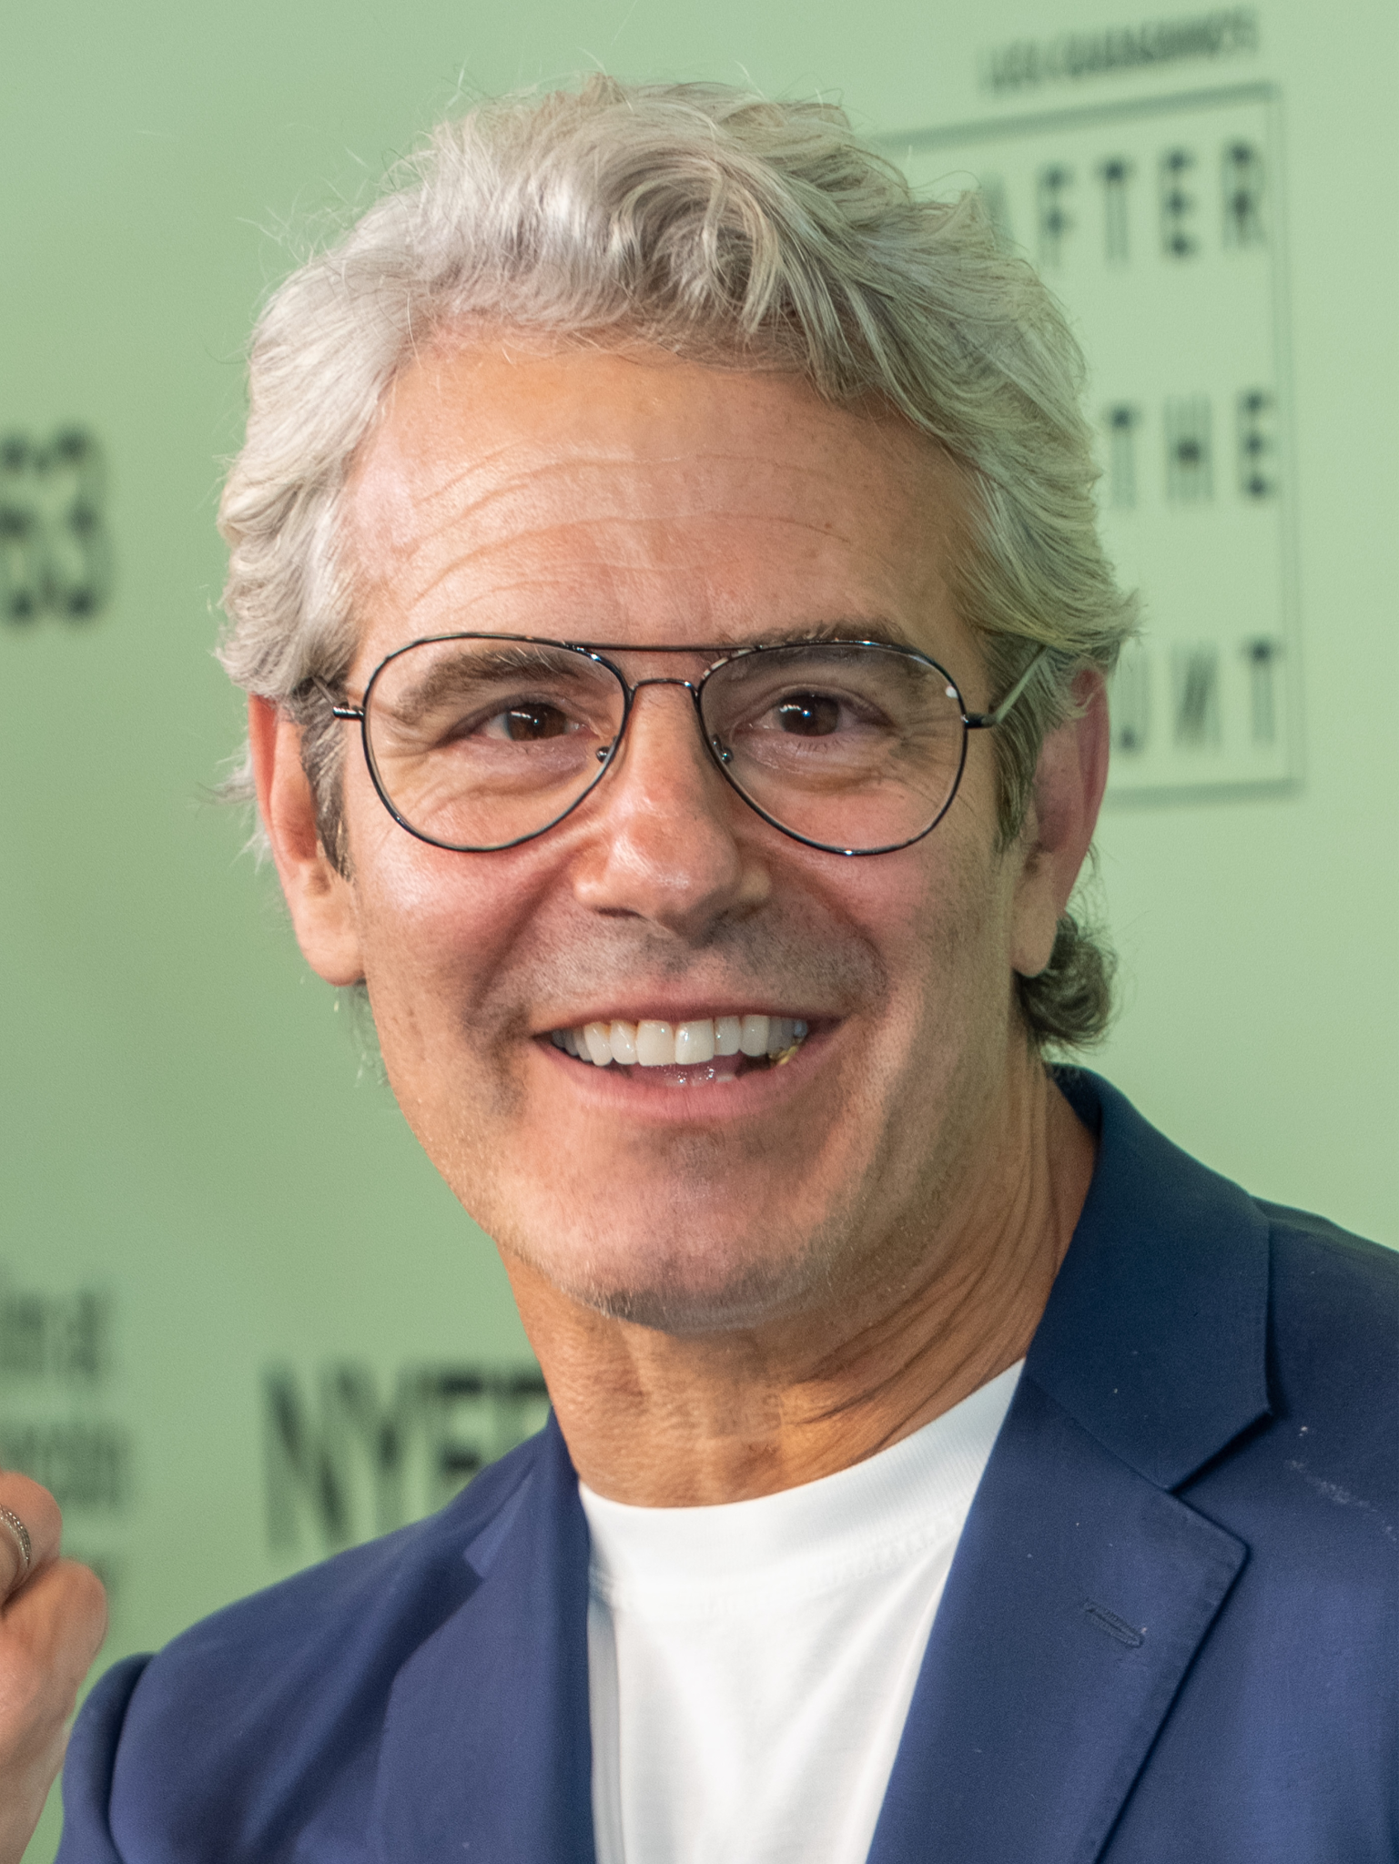
Notes:
Andy Cohen

Slide 2

Notes:
Beverly Hills

Slide 3
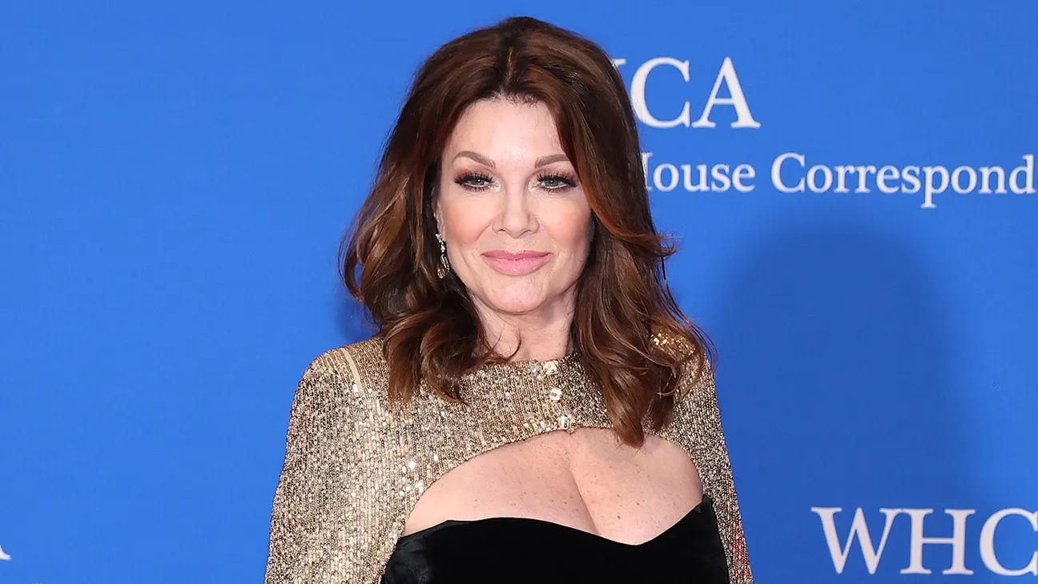
Notes:
Lisa Vanderpump

Slide 4

Notes:
Vicky Gunvalson

Slide 5
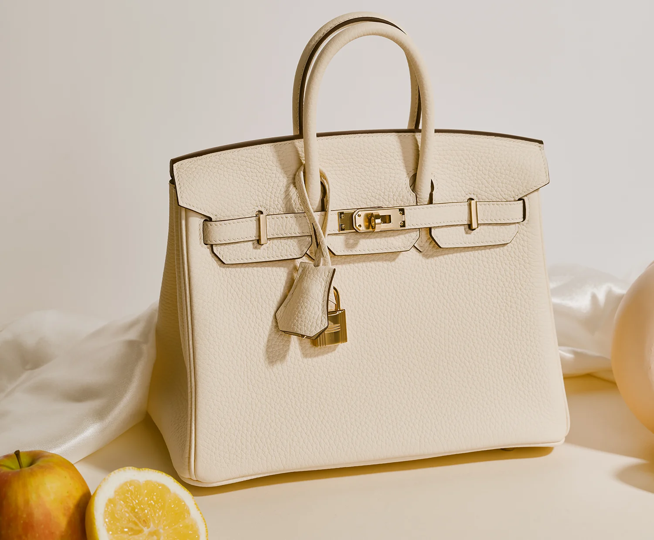
Notes:
Birkin Bag

Slide 6
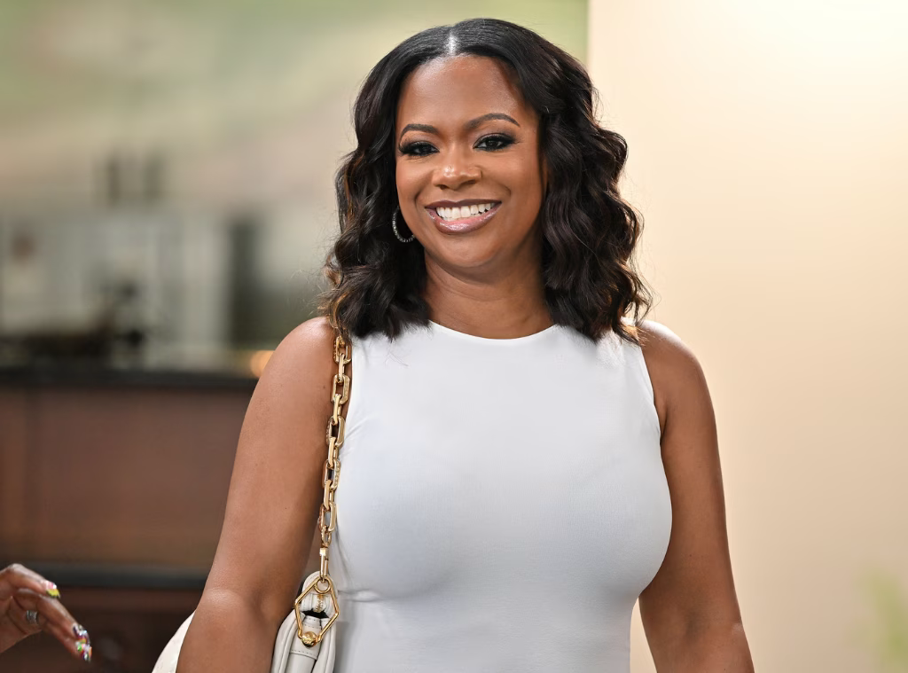
Notes:
Kandi Burruss

Slide 7
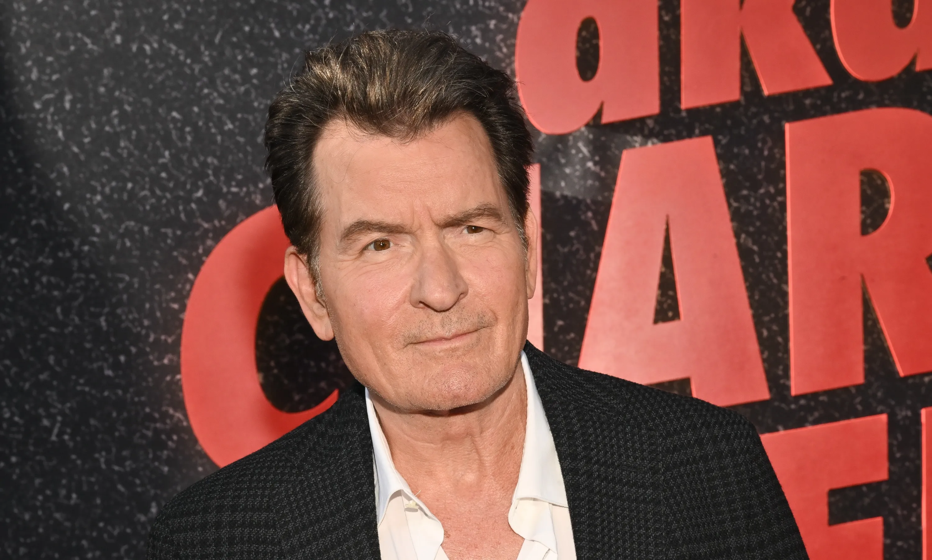
Notes:
Charlie Sheen

Slide 8

Notes:
Shannon Beado

Slide 9
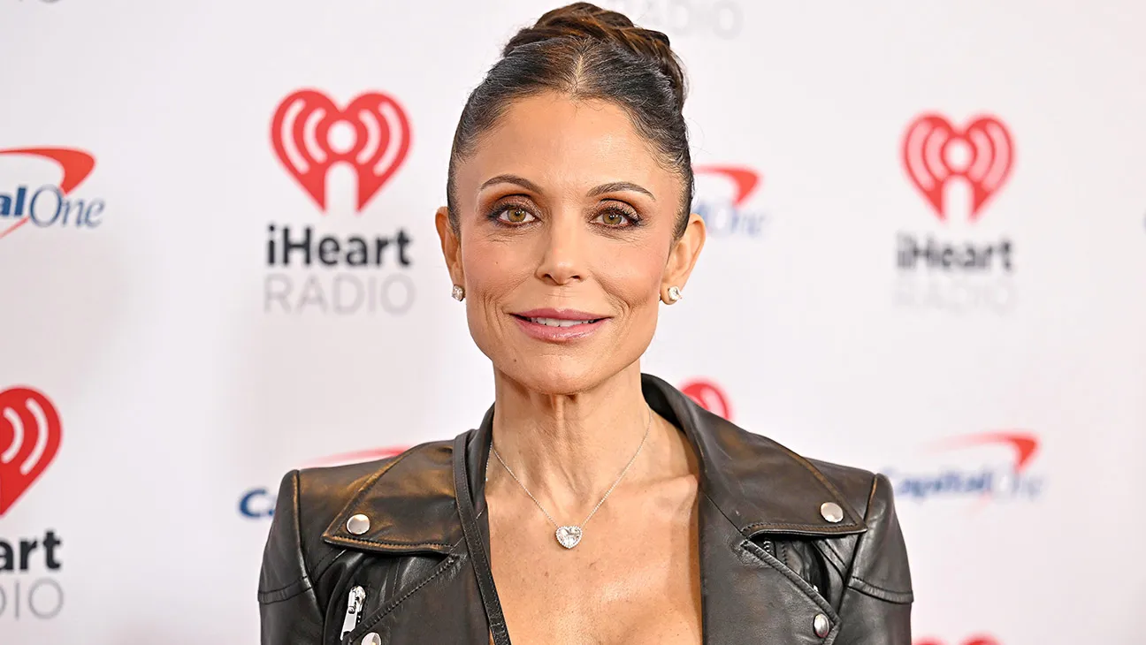
Notes:
Bethenny Frankel

Slide 10
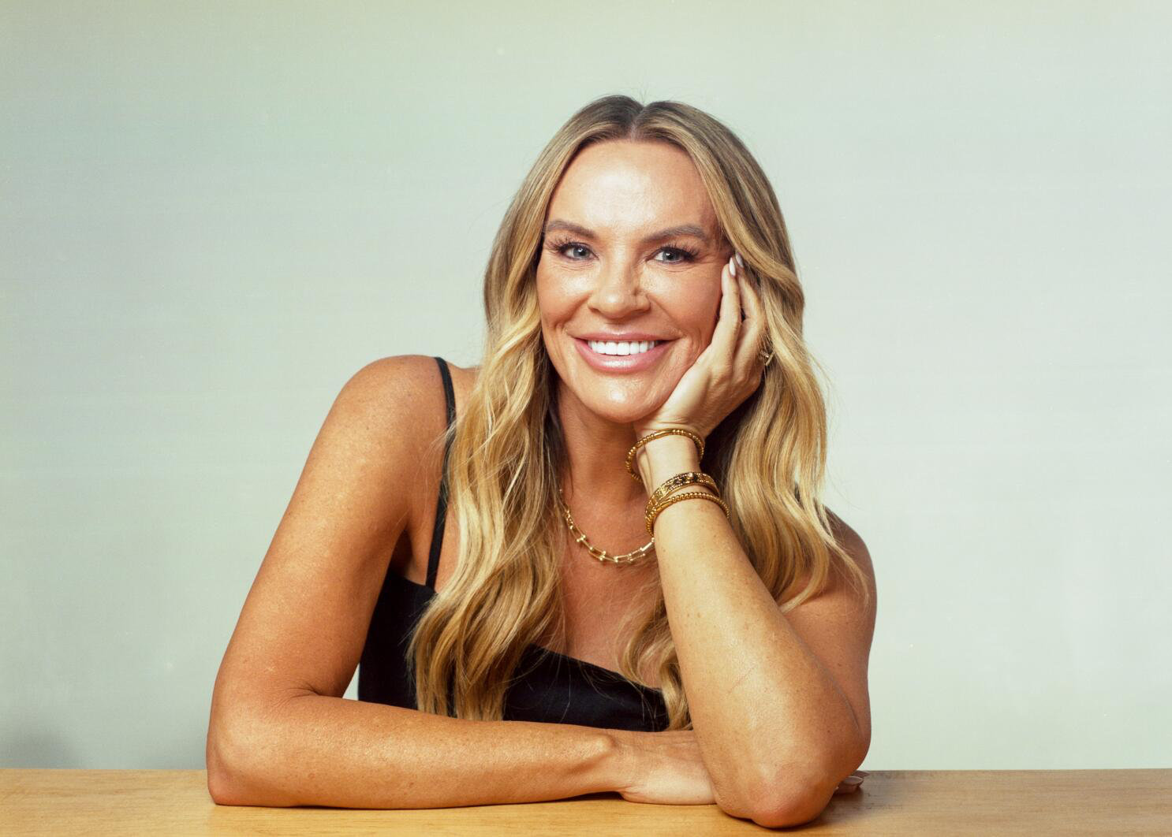
Notes:
Heather Gay

Slide 11

Notes:
Orange

Slide 12

Notes:
Cynthia Bailey

Slide 13
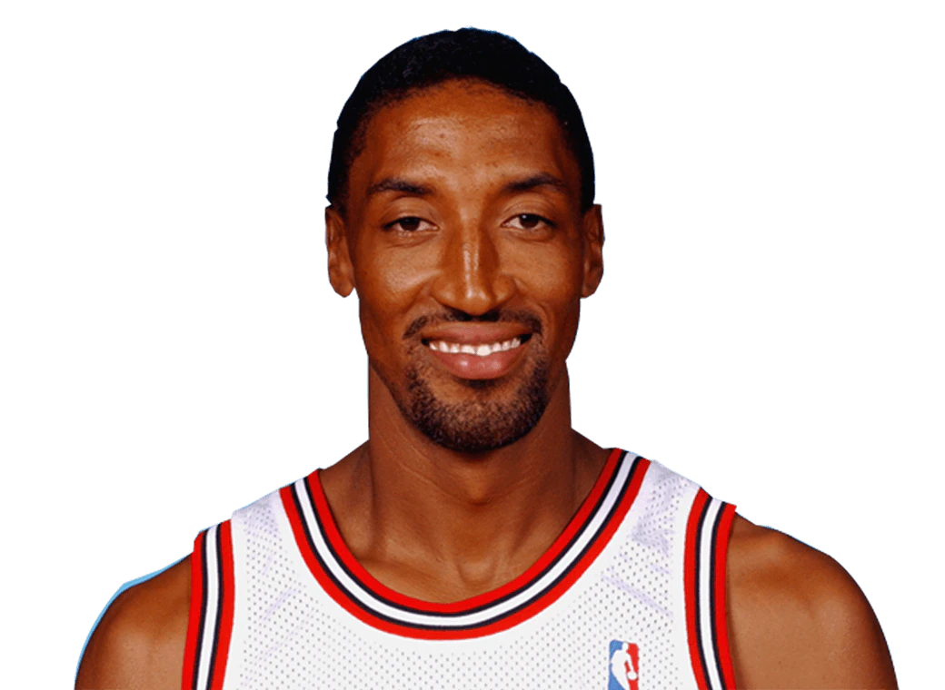
Notes:
Scottie Pippin

Slide 14

Notes:
Melissa Gorga

Slide 15

Notes:
Tamra Judge

Slide 16

Notes:
apple

Slide 17

Notes:
Salt Lake City

Slide 18

Notes:
Ramona Singer

Slide 19

Notes:
Skinny girl

Slide 20

Notes:
Luann de Lesseps

Slide 21

Notes:
Lisa Rinna

Slide 22

Notes:
Kenya Moore

Slide 23
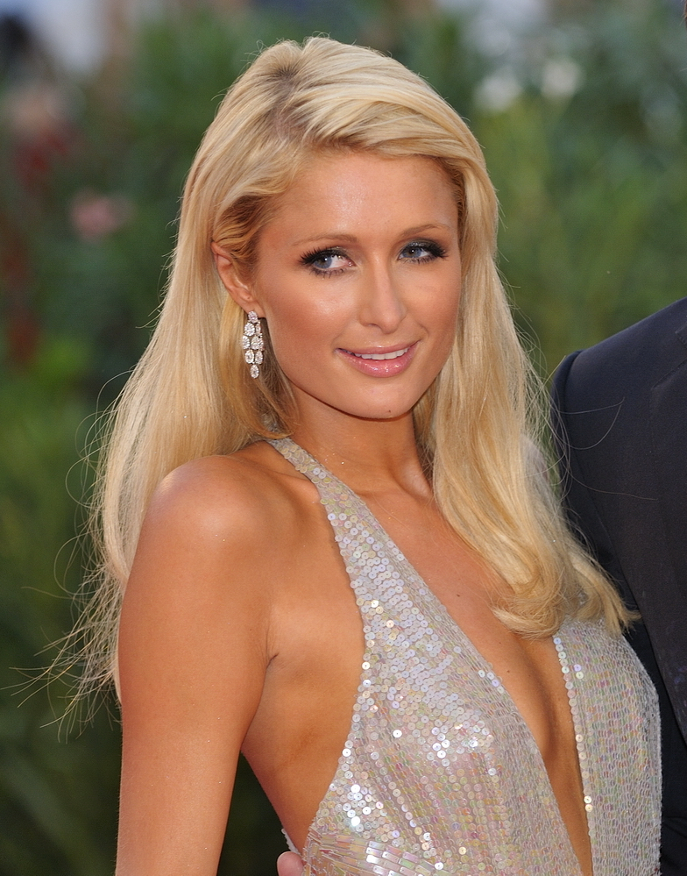
Notes:
Paris Hilton

Slide 24

Notes:
Vanderpump Rules

Slide 25
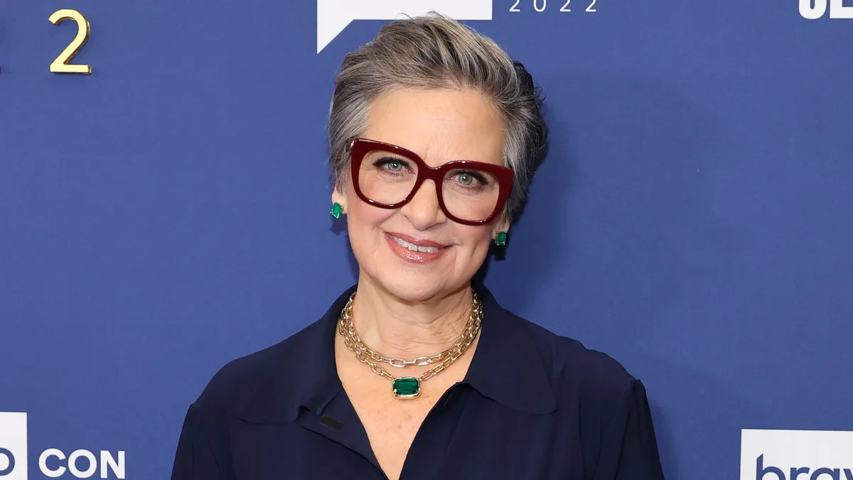
Notes:
Caroline Manzo

Slide 26

Notes:
Kisa Hochstein

Slide 27

Notes:
Gigi Hadid

Slide 28

Notes:
Potomac

Slide 29
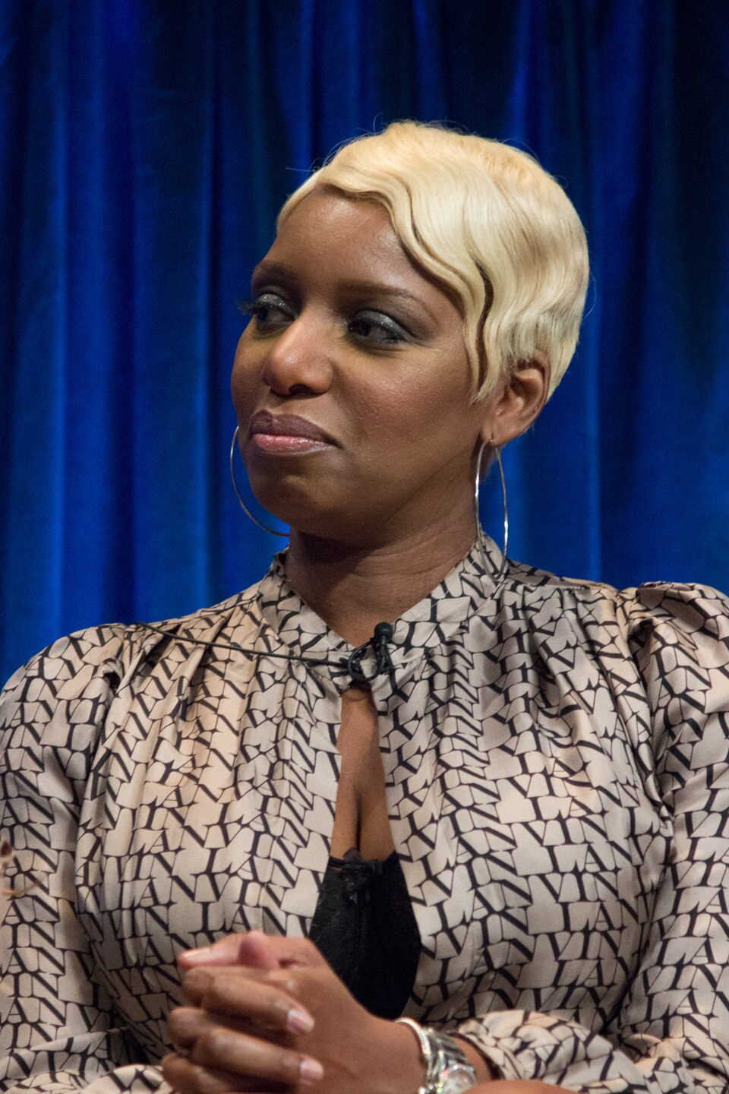
Notes:
NeNe Leakes

Slide 30

Notes:
Karen Huger

Slide 31

Notes:
Alexia Nepola

Slide 32

Notes:
Atlanta

Slide 33

Notes:
New York City

Slide 34
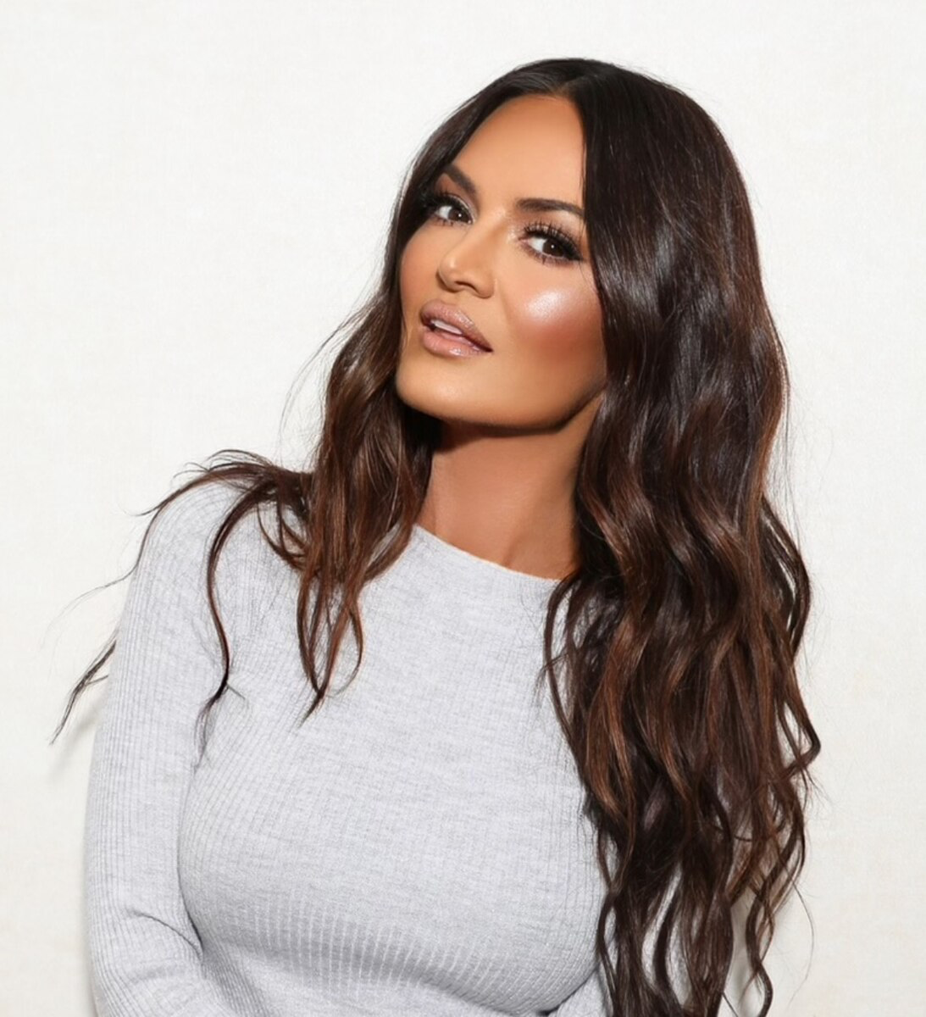
Notes:
Lisa Barlow

Slide 35
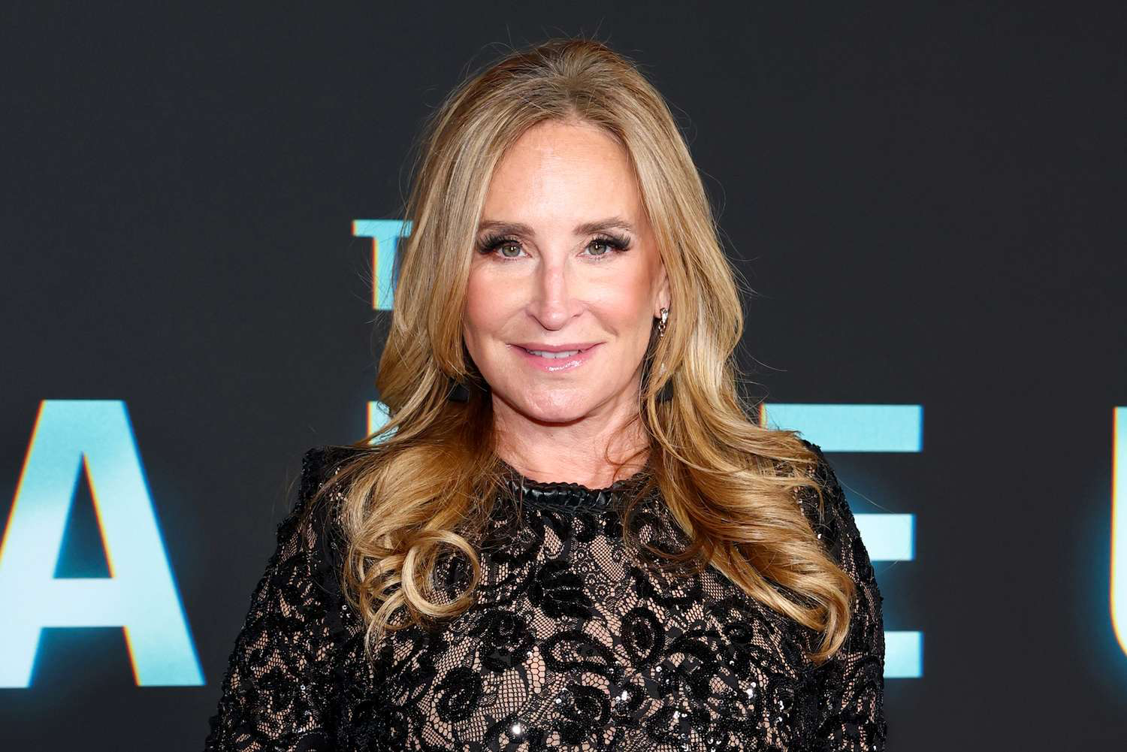
Notes:
Sonja Morgan

Slide 36
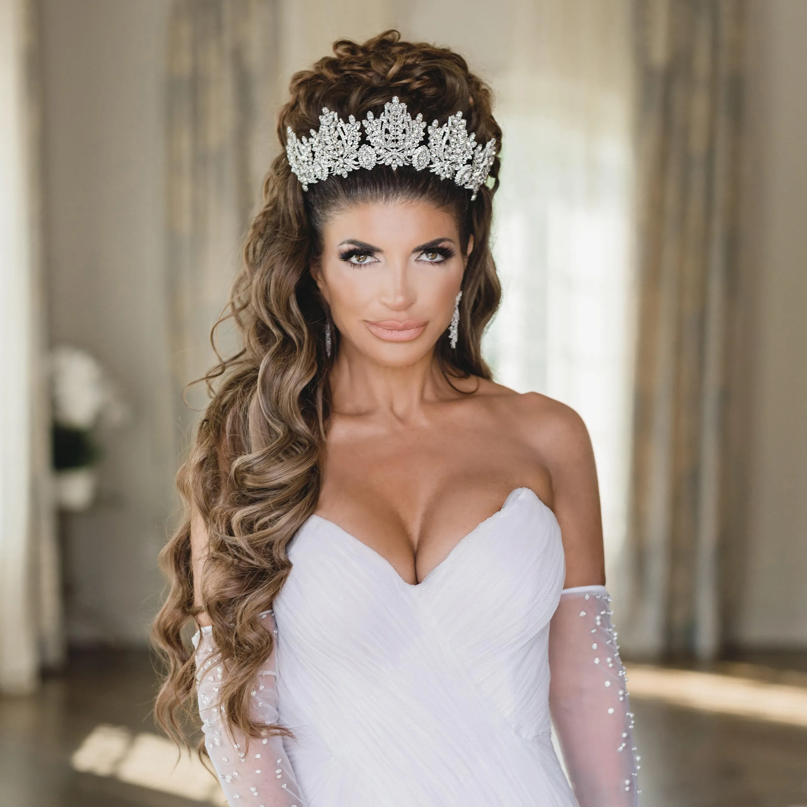
Notes:
Teresa Giudice

Slide 37

Notes:
Gizelle Bryant

Slide 38

Notes:
Dallas

Slide 39
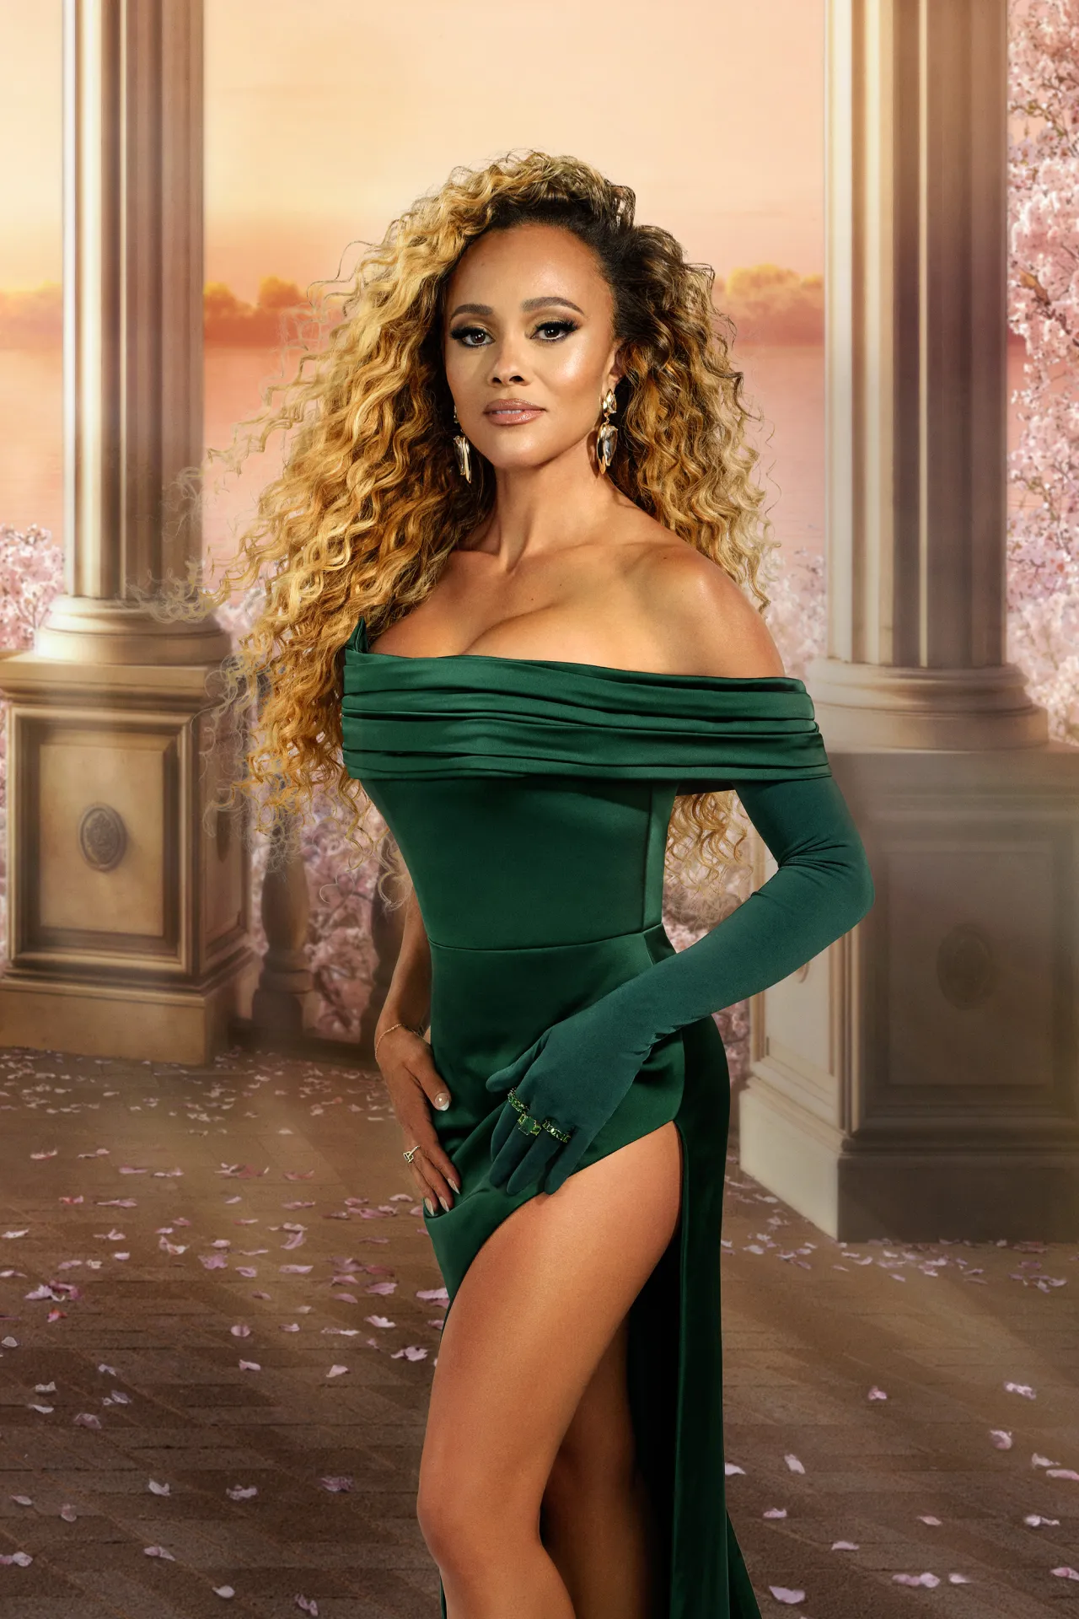
Notes:
Ashley Darby

Slide 40
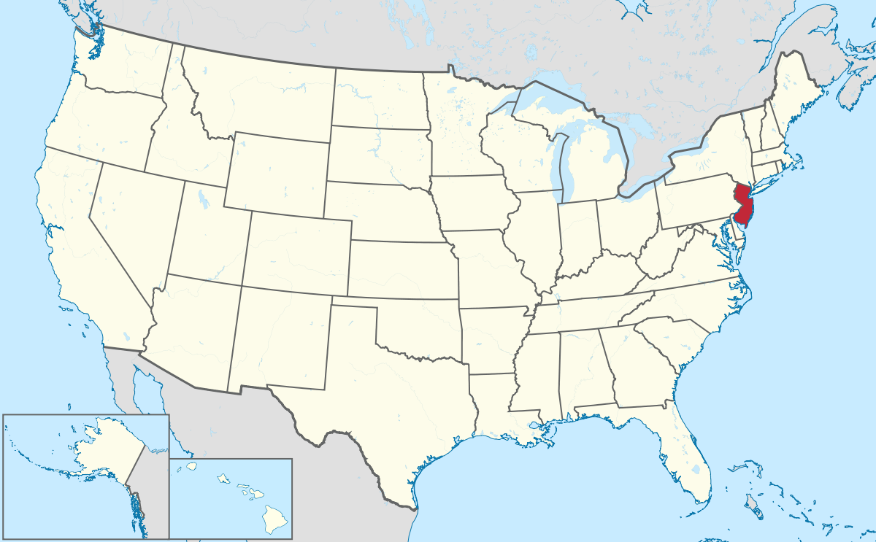
Notes:
New Jersey

Slide 41

Notes:
Dubai

Slide 42
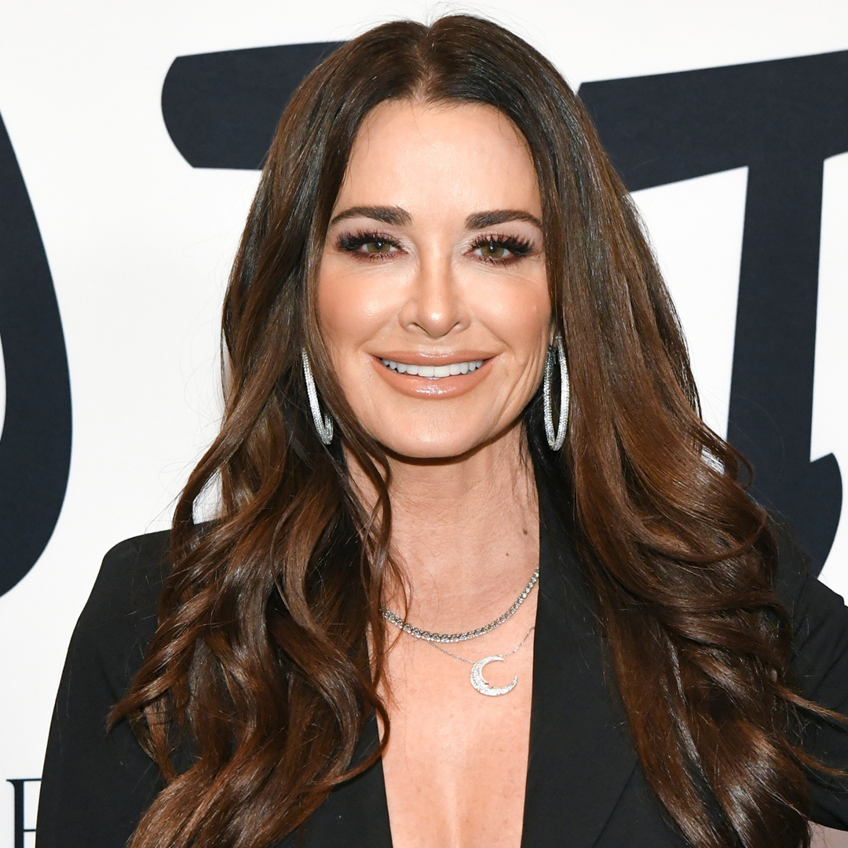
Notes:
Kyle Richards

Slide 43
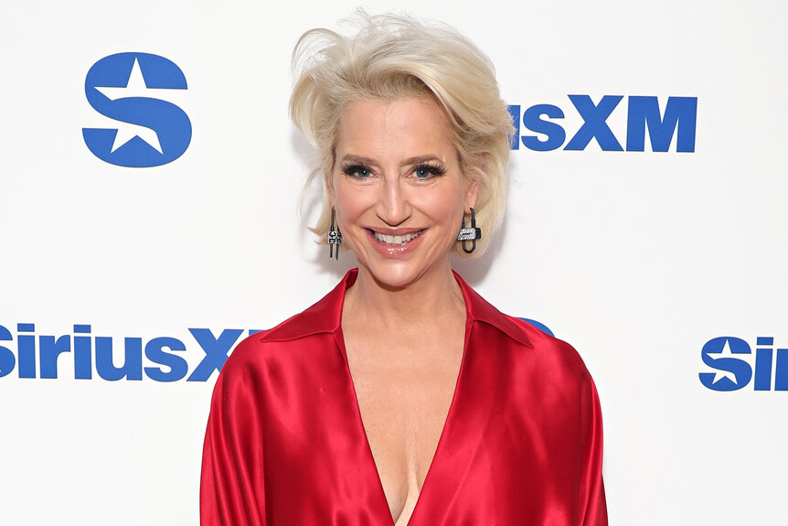
Notes:
Dorinda Medley

Slide 44
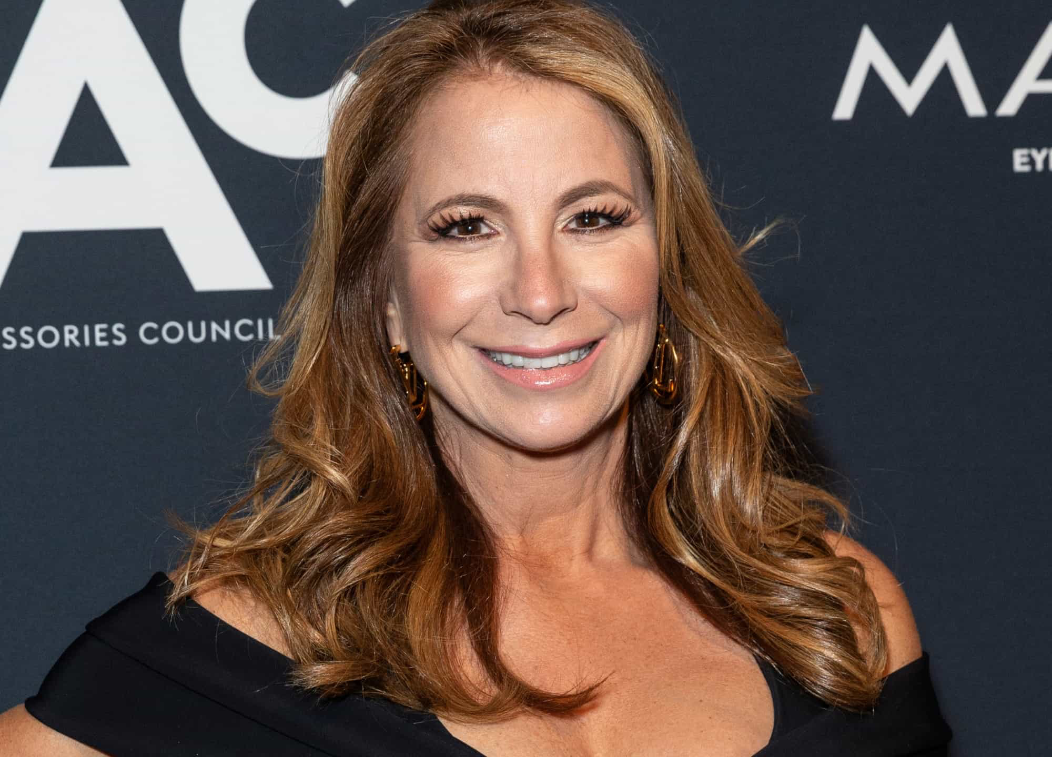
Notes:
Jill Zarin

Slide 45
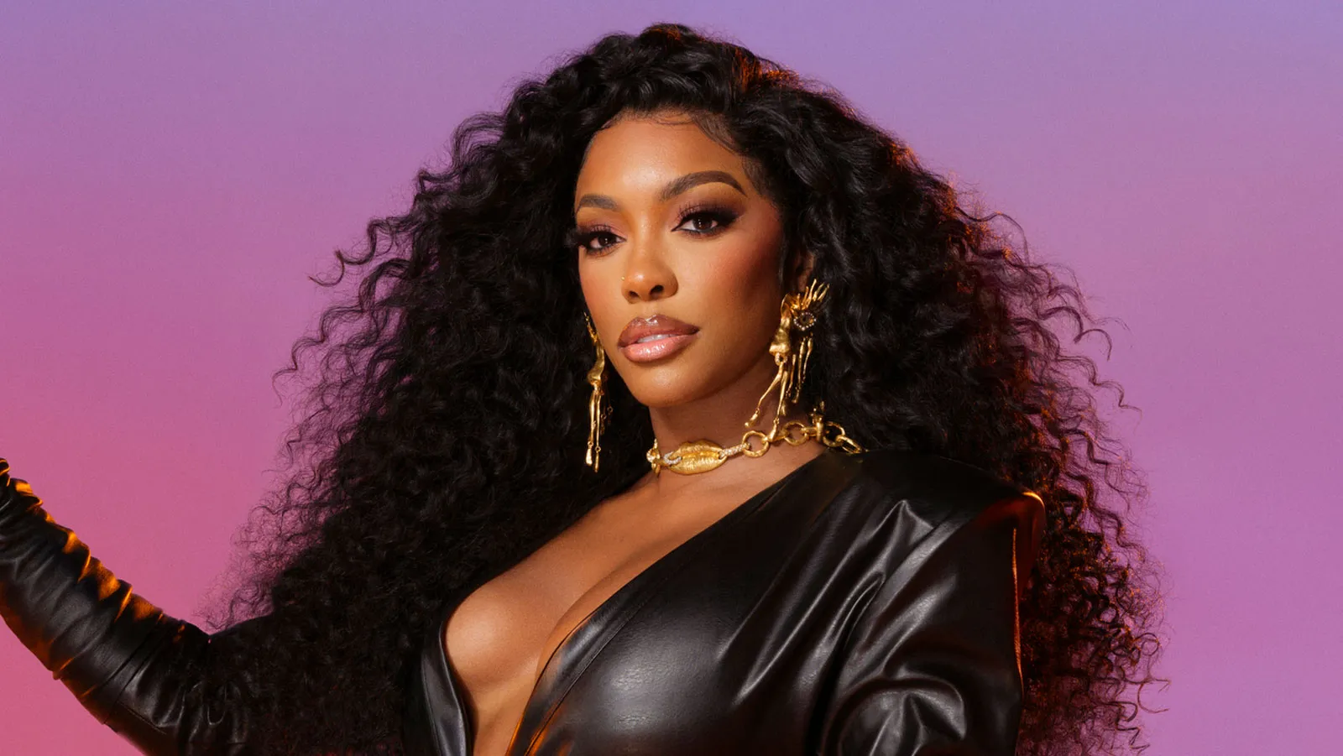
Notes:
Porhsa Williams

Slide 46

Notes:
Orange County

Slide 47
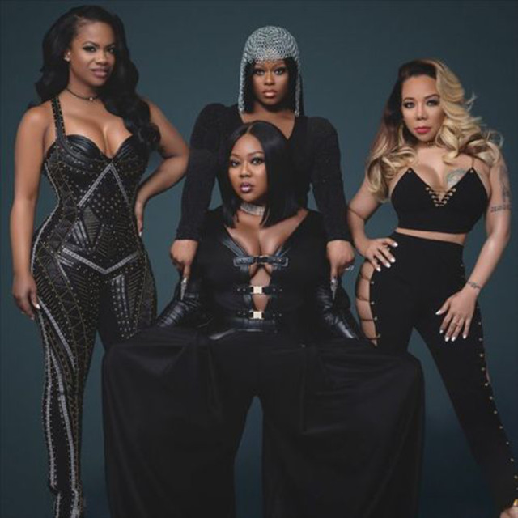
Notes:
Xscape

Slide 48
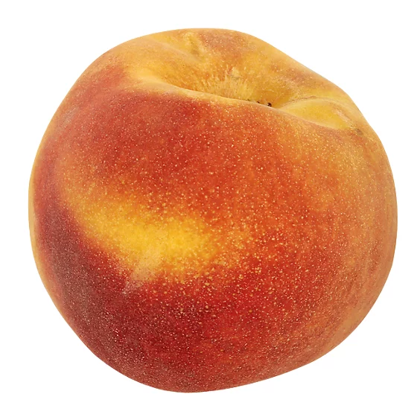
Notes:
peach

Slide 49
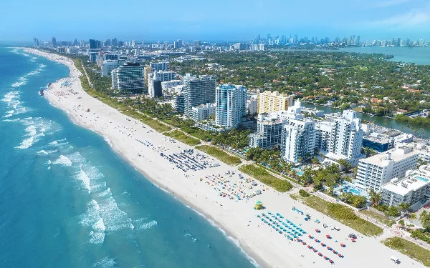
Notes:
Miami

Slide 50
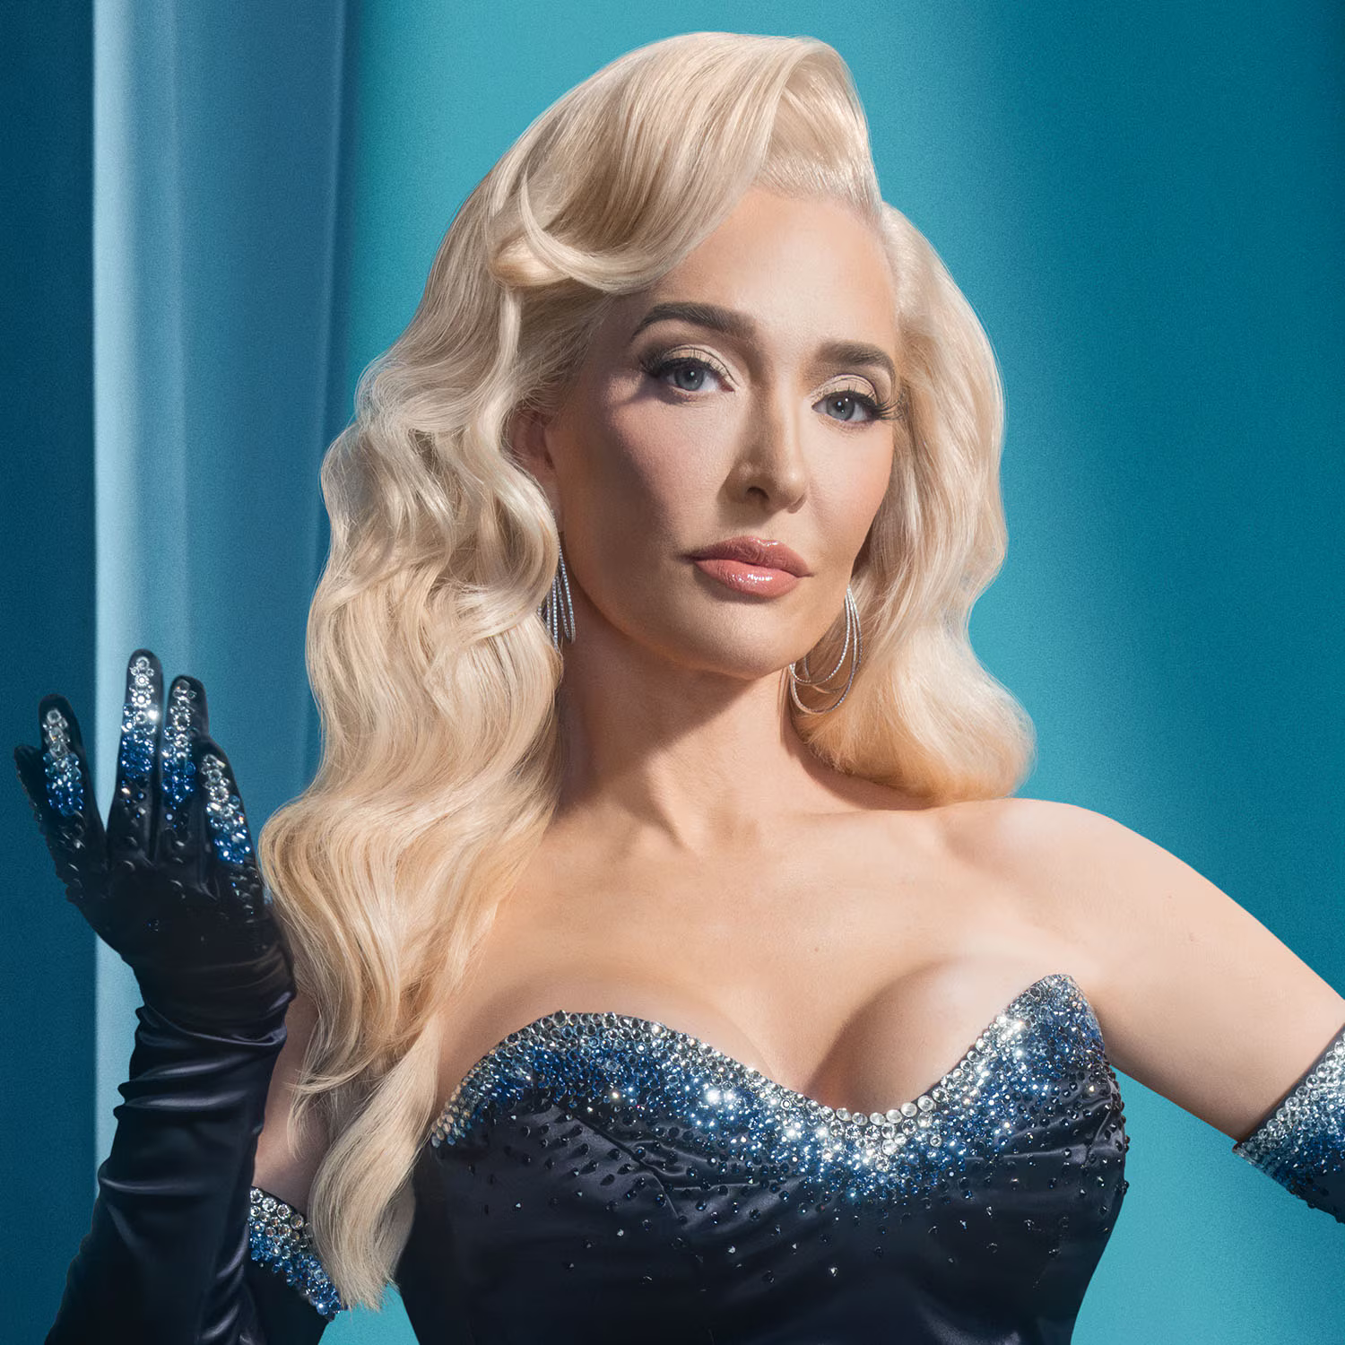
Notes:
Erike Jayne

